Slide 1

Data Storytelling & Hypothesis Testing
Data Analytics Internship | ApexPlanet Software Pvt. Ltd. | [Your Name]

Slide 2

The Business Challenge
ApexPlanet Software seeks to optimize its marketing strategies and revenue generation. Currently, there's a lack of clear understanding regarding which customer segments are most profitable and how age influences spending habits.
"Without targeted insights, our marketing efforts may be inefficient."
This analysis aims to identify high-value segments and provide data-backed recommendations.

Slide 3




Dataset at a Glance
Our analysis utilizes the Customer Purchase Behavior Dataset, providing a comprehensive view of customer interactions.
Demographics
Location
Product & Value
Payment Methods
Analyzes purchase behavior by city.
Includes customer age and gender for segmentation.
Details product categories and purchase amounts.
Identifies preferred transaction methods.

Slide 4

Key Exploratory Data Analysis (EDA) Insights
Initial exploration revealed crucial patterns in customer behavior.
Delhi & Bangalore Lead
Electronics: Top Revenue
UPI & Cash Preferred
These insights lay the groundwork for understanding our most valuable segments and operational strengths.

Slide 5
KPI Dashboard Summary
A dashboard was developed to track performance, focusing on key metrics.
100%
75%
Total Sales
Avg. Purchase Value
Overall revenue generated.
Per-transaction spending.
90%
85%
Top Product Category
Top City by Sales
Leading revenue stream.
Geographical performance.
This dashboard provides a clear, concise overview of our business health.

Slide 6


Hypothesis Formulation
To address the business problem, we formulated a specific hypothesis regarding age and spending.
Null Hypothesis (H₀)
There is no significant difference in spending behavior between different age groups.
Alternative Hypothesis (H₁)
Customers aged 36–45 demonstrate significantly higher spending compared to other age groups.

Slide 7
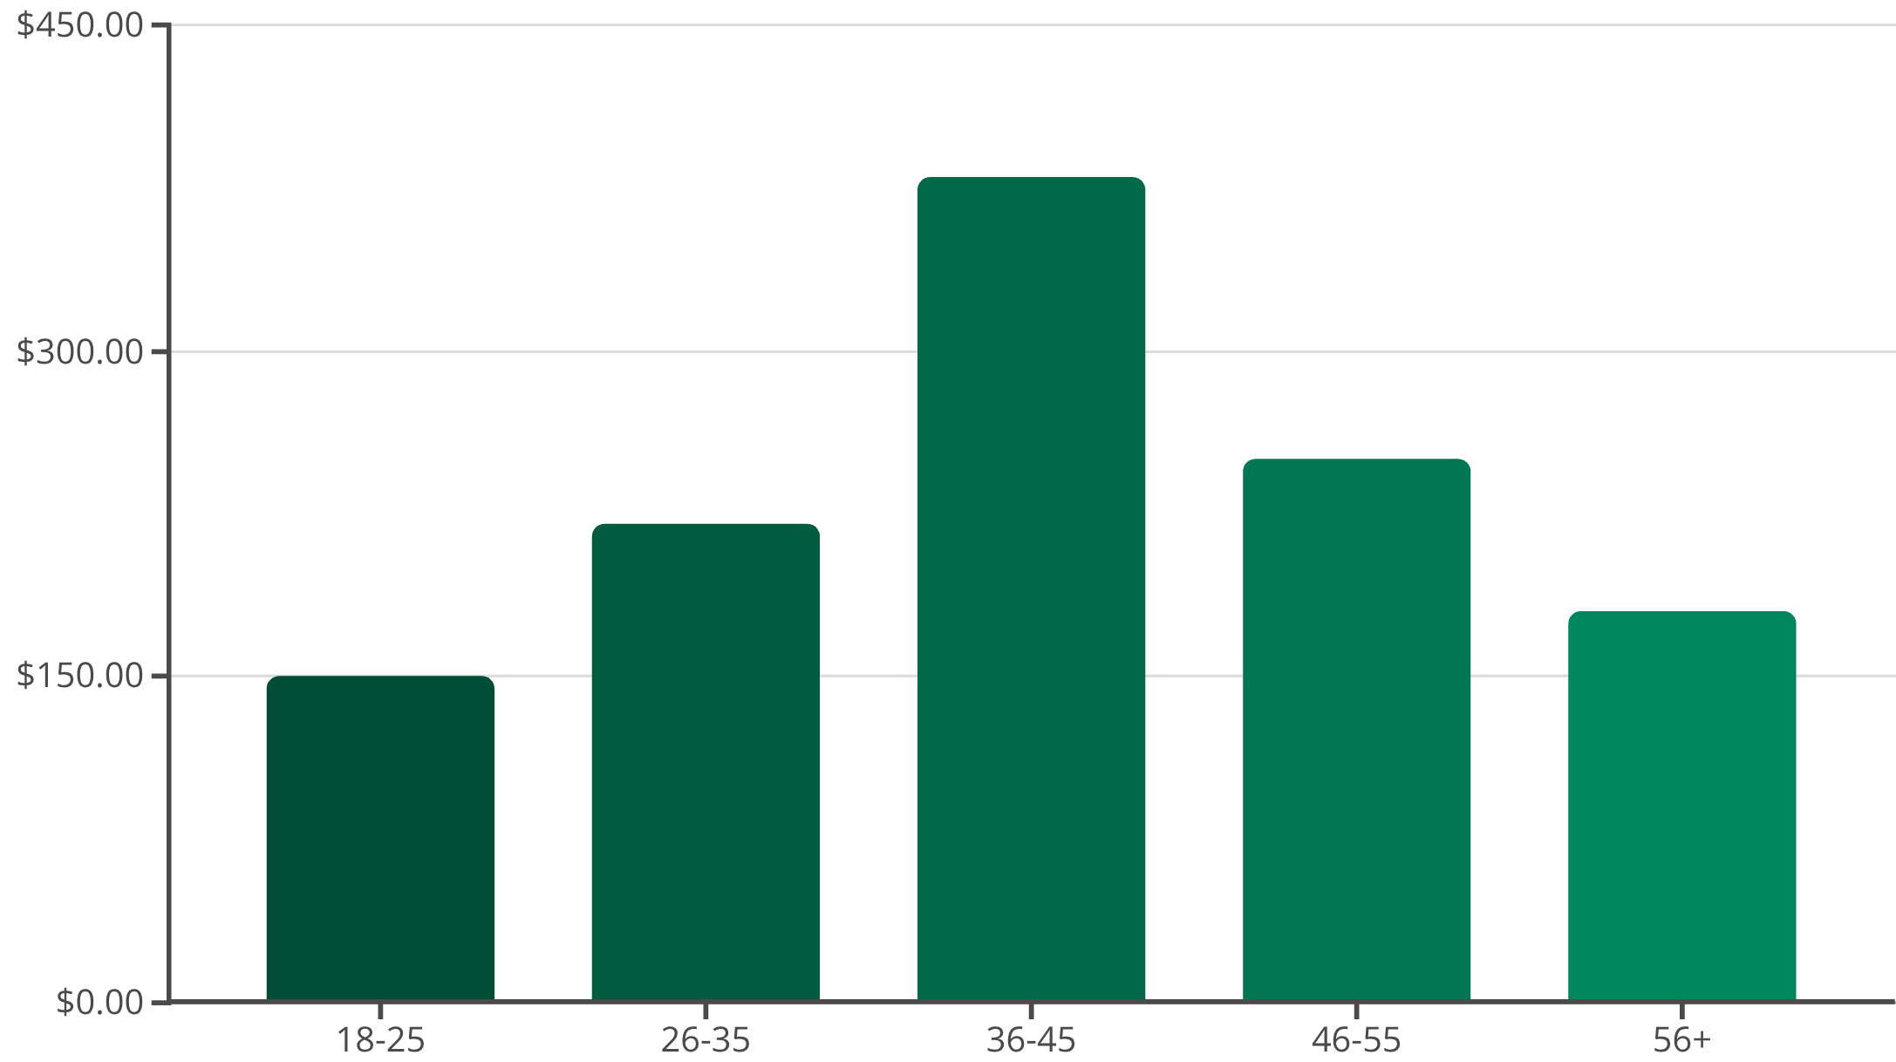
Statistical Test & Results
We performed an Independent T-Test to validate our hypothesis, analyzing the spending differences across age groups.
Independent T-Test
Test Performed: Independent T-Test
Significance Level: α = 0.05
P-Value: p < 0.05
Result: We reject the Null Hypothesis.
The statistical analysis confirms a significant difference in spending behavior among age groups, validating our alternative hypothesis.

Slide 8
Actionable Business Recommendations
Based on our data-driven findings, we propose the following strategic actions:
1
2
3
Target 36–45 Age Group
Promote Electronics Category
Focus on High-Performing Cities
Focus marketing campaigns and product development towards this high-spending segment.
Invest in inventory, merchandising, and specialized promotions for our top-performing product category.
Prioritize marketing spend and logistical support in Delhi and Bangalore to maximize sales impact.

Slide 9

Impact of Data-Driven Decisions
Implementing these recommendations can lead to substantial improvements in marketing effectiveness and revenue.
Increased Revenue
Optimized Marketing Spend
Enhanced Customer Understanding
By focusing on high-value customer segments and top-performing products.
Targeting specific demographics and geographies for better ROI.
Building richer profiles of our most profitable customers.

Slide 10

Conclusion: Unlocking Growth Through Data
This internship project demonstrates the powerful potential of data analytics in transforming business strategy.
"Age-based segmentation provides actionable insights that directly impact marketing efficiency and revenue generation."
By embracing data-driven decisions, ApexPlanet Software can achieve sustainable growth and competitive advantage.

